Slide 1

School of Computer Science and Engineering IILM University, Greater Noida, U.P.
Internship Topic/Title: Artificial Intelligence Internship Student Name: ADARSH YADAV Enrollment Number: 25SCS100302441 Program & Semester: B.Tech CSE – Semester III Organization: Codec Technologies Pvt. Ltd. Internship Dates: 07 July 2026 – 07 August 2026

Slide 2
IILM UNIVERSITY
Artificial Intelligence Internship Codec Technologies Pvt. Ltd.
INTERNSHIP PRESENTATION
Student Name
ADARSH YADAV
Roll Number
2441
Program & Semester
B.Tech CSE | Semester III
Batch
2025–29
Organization
Codec Technologies Pvt. Ltd.
Internship Dates
07 July 2026 – 07 August 2026
Codec Technologies – Artificial Intelligence Internship | Adarsh Yadav
1

Slide 3
1. Introduction
Internship overview
What was the internship?
Purpose
A one-month Artificial Intelligence internship at Codec Technologies Pvt. Ltd., conducted from 07 July 2026 to 07 August 2026.
The internship provided industry-oriented exposure through
assigned projects, training tasks and professional practices.
Academic connection
The experience connected B.Tech CSE learning with an AI-oriented professional environment and highlighted communication, task management and professional discipline.
Codec Technologies – Artificial Intelligence Internship | Adarsh Yadav
2

Slide 4
2. Organization Profile
Codec Technologies
Codec Technologies Pvt. Ltd.
Industry reach
Internship setting
The offer letter describes Codec Technologies as a global platform focused on empowering learners and connecting diverse talent with career opportunities.
Dedicated IT and business consultancy services across 27+ countries.
The internship was organized through Codec Technologies and supervised by assigned project head(s).
Why the organization mattered
It provided a structured professional setting for industry-oriented learning, assigned project work, training tasks and supervised participation.
Codec Technologies – Artificial Intelligence Internship | Adarsh Yadav
3

Slide 5
3. Internship Details
Program structure
• Designation: Artificial Intelligence Intern • Duration: 07 July 2026 to 07 August 2026 (1 Month) • Location & Mode: Pan India, Hybrid • Reporting: Assigned Project Head(s) • Work format: Assigned projects and training tasks through the organization’s platform and email • Programme: 1 Month AICTE & ICAC Approved internship
Focus: industry-oriented AI exposure, practical learning and completion of assigned internship requirements.
Codec Technologies – Artificial Intelligence Internship | Adarsh Yadav
4

Slide 6
4. Objectives of the Internship
Learning goals
Gain AI exposure
Understand project work
Build industry skills
Gain practical exposure to an Artificial Intelligence-oriented professional environment.
Understand how project and training tasks are handled in an organization.
Develop industry-oriented knowledge
and skills.
Connect academics
Improve professionalism
Work under guidance
Connect academic concepts with
practical learning.
Strengthen professional discipline
and communication.
Complete assigned tasks under
the guidance of project head(s).
Codec Technologies – Artificial Intelligence Internship | Adarsh Yadav
5

Slide 7
5. Artificial Intelligence Learning Exposure
AI-oriented scope
AI-oriented environment
Academic integration
Documented scope
The internship designation was Artificial
Intelligence Intern, providing exposure to an AI-oriented learning and project environment.
The experience offered
an opportunity to relate academic concepts to industry-oriented learning and assigned tasks.
The provided documents do not specify exact programming languages, tools, datasets, AI models or individual project names; these are therefore not claimed.
Codec Technologies – Artificial Intelligence Internship | Adarsh Yadav
6

Slide 8
6. Training & Working Approach
How the internship was structured
01
02
03
04
Training
Assigned Tasks
Supervision
Evaluation
Industry-oriented knowledge and relevant skills were developed through training activities.
Interns were instructed to complete assigned projects and training tasks through the platform and email.
The intern reported to assigned project head(s), providing a structured approach to completing requirements.
Exceptional interns could qualify for a scholarship award based on weekly performance reviews by the project supervisor.
Codec Technologies – Artificial Intelligence Internship | Adarsh Yadav
7

Slide 9
7. Skills Developed
Professional growth
AI technical awareness
Project-based learning
Professional communication
Exposure to Artificial Intelligence as
an industry-oriented field.
Understanding of project and
training-based learning.
Improved communication and
professional interaction.
Task management
Supervised work
Career development
Experience in following instructions and
completing assigned tasks.
Working under project supervision and
meeting internship requirements.
Exposure to an organizational environment
relevant to future internships and placements.
Overall: broader professional awareness alongside Artificial Intelligence-oriented learning.
Codec Technologies – Artificial Intelligence Internship | Adarsh Yadav
8

Slide 10
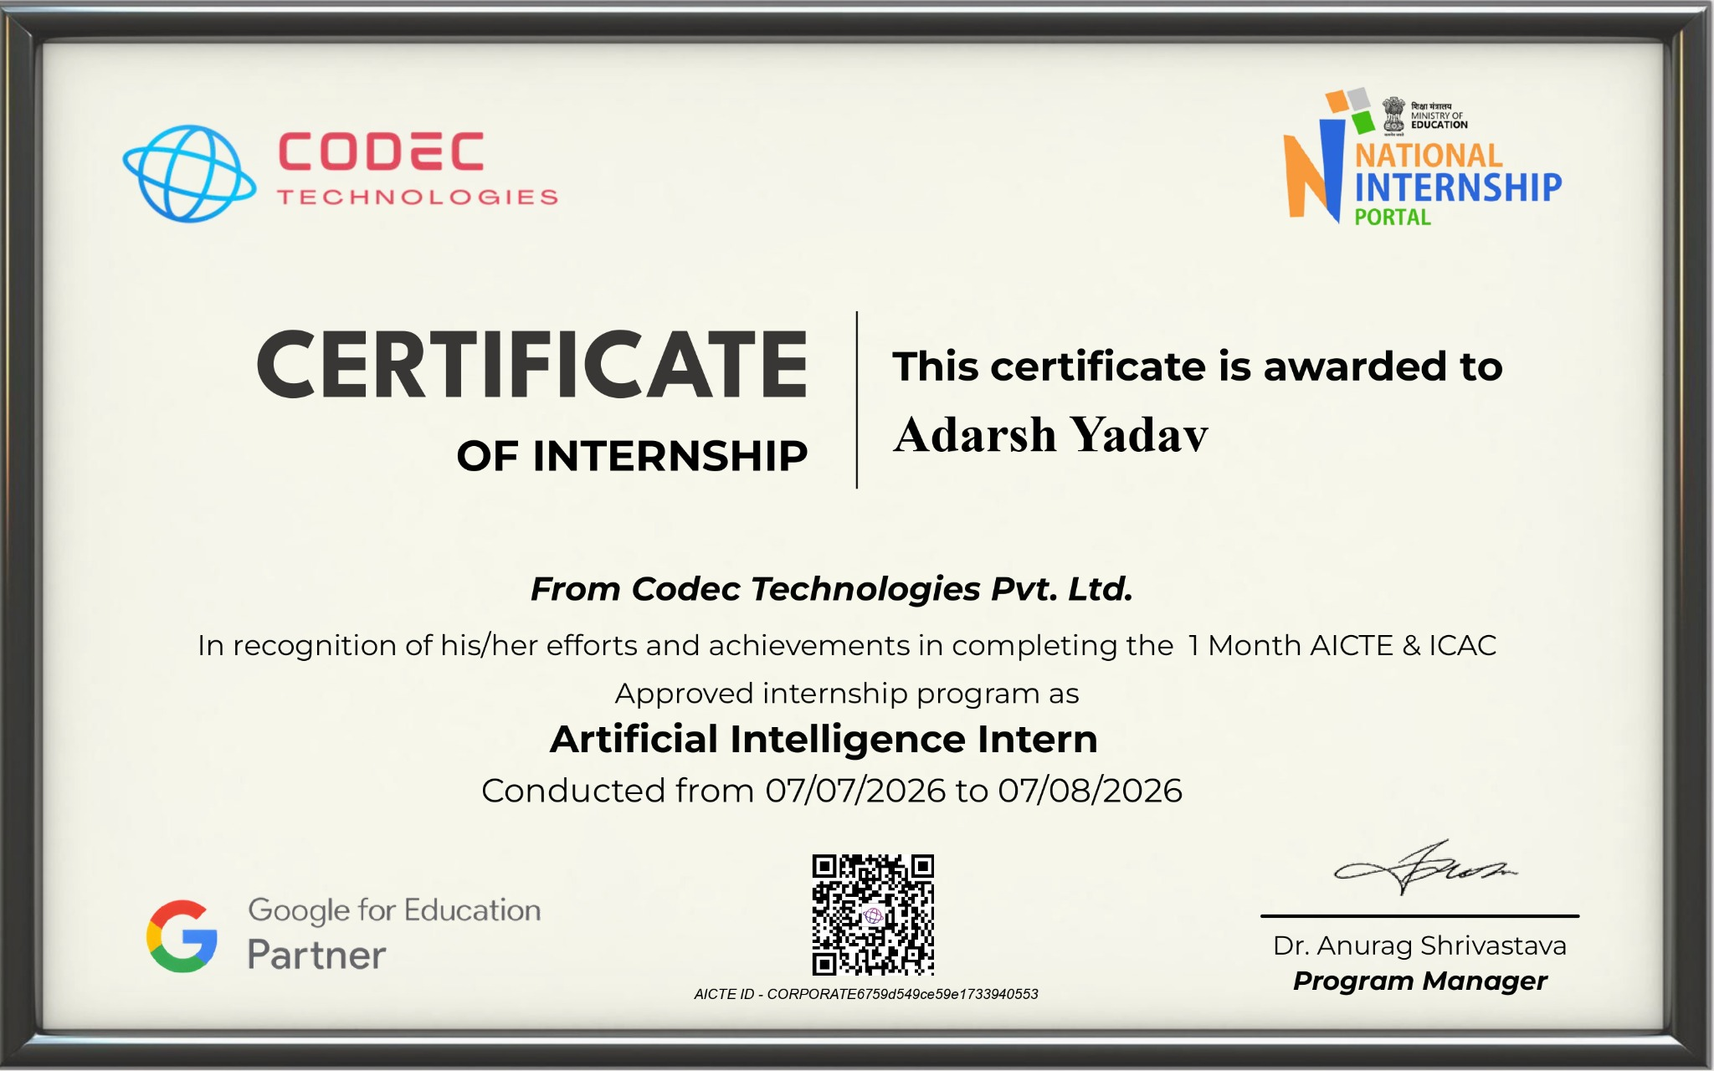
8. Internship Completion Certificate
Evidence
Certificate Details
Adarsh Yadav Artificial Intelligence Intern AICTE & ICAC Approved – 1 Month 07/07/2026 – 07/08/2026
Adarsh Yadav Artificial Intelligence Intern 1 Month AICTE & ICAC Approved internship programme 07/07/2026 to 07/08/2026
Verification details
Program Manager: Dr. Anurag Shrivastava AICTE ID: CORPORATE6759d549ce59e1733940553
Certificate issued by Codec Technologies Pvt. Ltd.
Codec Technologies – Artificial Intelligence Internship | Adarsh Yadav
9

Slide 11

9. Internship Offer Letter
Official offer and internship details
Offer Letter Highlights
Designation
Artificial Intelligence Intern
Location & Mode
Pan India, Hybrid
Duration
07/07/2026 – 07/08/2026
Reporting
Assigned Project Head(s)
Organization
Codec Technologies
Date of Issue
07/07/2026
NCS ID
E19E86-0116588288923
AICTE ID
CORPORATE6759d549ce59e1733940553
Assigned projects and training tasks were to be completed through the platform and email.
Codec Technologies – Artificial Intelligence Internship | Adarsh Yadav
9

Slide 12
9. Internship Outcomes & Conclusion
Reflection
Key Takeaway
Internship outcomes
The one-month Artificial Intelligence internship provided industry-oriented exposure alongside academic learning. It strengthened professional communication, task management, supervised project work and awareness of AI as a career-oriented field.
• Completed a one-month AI internship. • Participated in assigned project and training activities. • Developed professional communication and task-management skills. • Gained experience working under project supervision.
Relevance to CSE
The internship complemented B.Tech CSE studies by adding practical, professional and AI-oriented exposure that can support future technical projects, internships and placement preparation.
Codec Technologies – Artificial Intelligence Internship | Adarsh Yadav
10

Slide 13
10. References & Supporting Documents
Sources
1. Codec Technologies Pvt. Ltd. – Internship Offer Letter. 2. Codec Technologies Pvt. Ltd. – Certificate of Internship. 3. Adarsh Yadav – Internship Report: Artificial Intelligence Internship. 4. B.Tech Computer Science and Engineering academic coursework.
Codec Technologies website: www.codectechnologies.in AICTE ID: CORPORATE6759d549ce59e1733940553
Thank You
Codec Technologies – Artificial Intelligence Internship | Adarsh Yadav
11

